Slide 1

ZOMATO
RESTAURANT

Slide 2
INTRODUCTION
🌍 Global Food-Tech Leader:
Founded in 2008, Zomato has expanded to over 20 countries, redefining how people connect with food.
📖 Comprehensive Information Hub:
Users access menus, reviews, ratings, and photos to make informed dining choices.
👥 Massive Reach:
With 80+ million monthly active users and partnerships with 1.6 million restaurants worldwide, Zomato is a trusted platform at scale.
🚀 Restaurant Growth Partner:
Beyond discovery, Zomato empowers restaurants with tools to manage listings, engage customers, and drive business growth.
🍴 Seamless User Experience:
From online ordering and table reservations to exploring nearby eateries, Zomato makes dining effortless.
INTRODUCTION

Slide 3
HOW ZOMATO WORKS
🔍 For users: Search restaurants by location, cuisine, ratings, or price; explore menus, reviews, and photos; order food or book tables easily.
🍴 For restaurants: Manage profiles, update menus, respond to feedback, and access performance insights.
🤝 Two-way system: Enhances food discovery and ordering for users while helping restaurants grow and serve better.
-Samira Hadid

Slide 4
AGENDA
Problem Statement
Strategic Recommendation
Data Overview
Conclusion
Data Snapshot
Objective Key Metrics & Visualization
Insightful Observations

Slide 5
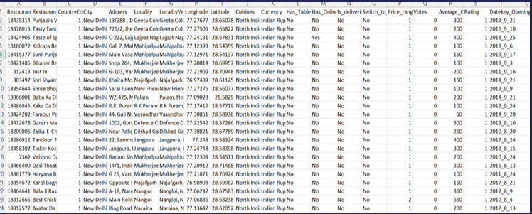
Problem Statement
You are hired as a consultant data analyst by Zomato where the team is looking for expansion and opening restaurants. Your task is to come up with strategies/suggestions about opening newer restaurants.

Slide 6
Zomato Data Overview
●The dataset includes details for 9,551 restaurants, with 20 columns capturing various attributes of each establishment. Here's a brief overview of the information available in the dataset:
●Restaurant ID: Unique identifier for each restaurant.
●Restaurant Name: The name of the restaurant.
●Country Code : Country code of the location where the restaurant is situated.
●City: The city where the restaurant is located.
●Address: The Specific address of the restaurant.
●Locality: The locality of neighborhood where the restaurant is situated.
●Locality Verbose: Detailed information about the locality.
●Longitude: The geographical longitude coordinate of the restaurant.
●Latitude: The geographical latitude coordinate of the restaurant.
●Cuisines: The type of cuisines offered by the restaurant.
●Currency: The currency used for transactions in the restaurant.
●Has-Table-Booking: Indicates table booking option in the restaurant.
●Has-Online-delivery: Indicates online delivery in the restaurant.
●Is-Delivering-Now: Indicates the restaurant is delivered now.
●Price Range: Indicate price range category of the restaurant.
●Votes : The number of votes of ratings received by the restaurant.
●Average-cost-for-two : The average cost for two people dining at the restaurant.
●Rating: indicates the restaurant performance.
●Datekey-opening: opening date of the restaurant.

Slide 7
Zomato Data Snapshot
●Total Number of Restaurants: From 2010 to 2018, 9551 restaurants were established in 15 countries.
●Number of Cities: There are 141 cities with a variety of restaurants.
●Variety of Cuisines: With 1825 different types of cuisines, including popular choices like Italian, Mexican, Chinese, Indian and American, each cuisine adds its distinct flavors, ingredients, and cooking methods, enriching the diverse world of gastronomy.
●Ratings: Restaurant ratings with average of 2.9, provide insights into the performance of each establishment.
●Online services: Shows availability of table booking, online delivery, and current delivery status.

Slide 8
Dataset & Cleaning Summary
Overview of tables, attributes, and cleaning steps to prepare data.
●Tables: Restaurants, Countries, and additional attribute tables.
●Attributes: Restaurant ID, Name, Country Code, City, Address, Locality, Cuisine, Average Cost for Two, Currency, Has Table booking, Has Online delivery, Aggregate rating, Votes.
●Cleaning Steps:
○Handling missing values
○Data type conversion (e.g., ratings to numeric)
○Removing duplicates
○Standardizing country codes
○Ensuring data consistency

Slide 9
Analytical Method and Tools
●Data Cleaning: I used functions like TRIM to remove extra spaces and PROPER to set a word in proper condition. I also filled rows with missing values to ensure the dataset was clean and reliable.
●Data Enrichment: Using the TEXT function, I extracted specific date components, and with VLOOKUP, I added columns such as country names to improve the overall clarity and context of the dataset.
●Descriptive Analysis: I used Pivot Tables to break down and analyze data based on countries, cuisines, pricing, and ratings. This helped me identify key trends and compare various aspects of restaurant performance.
●Visualization: I created different types of charts to visually represent the data, which made it easier to spot patterns, track comparisons, and share insights in a clear and engaging way.
"The ambience is pure class – calming, luxurious, and beautifully designed."
-Samira Hadid
-Reese Miller

Slide 10
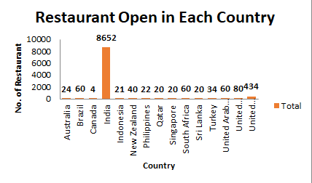
RESTAURANT DISTRIBUTION BY COUNTRY
•The graph shows that India and the United States have the highest number of restaurants opened, which means there is more competition in these countries.
•Canada has the lowest number of restaurant openings over the years.
•Other countries have between 20 to 80 restaurants opened.
•This graph can help the management decide where to open new restaurants in the future.

Slide 11
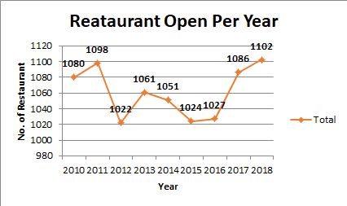
Number of Restaurants Opened in Each Year
•In 2018, the highest number of restaurants were opened.
•The year 2012 had the lowest number of restaurant openings.
•Overall, from 2010 to 2018, the number of restaurants gradually increased each year.
•This trend can be useful for future analysis to check if there are any changes in the pattern of restaurant openings.

Slide 12
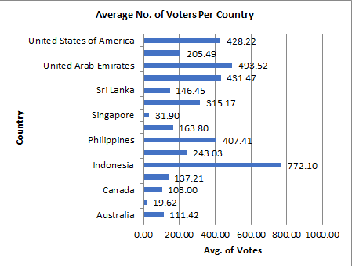
Average Number of Votes in Each Country
The number of votes gives an idea of the average footfall or customer engagement in restaurants across different countries.
Indonesia has the highest average number of votes, suggesting more customer activity or feedback.
Brazil and Singapore have the lowest average votes, indicating relatively lower customer interaction.

Slide 13
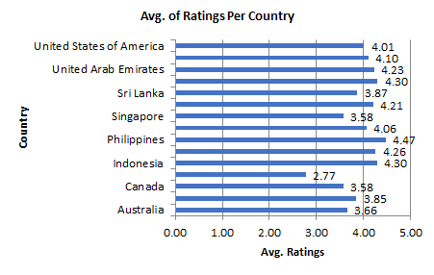
Average Number of Ratings in Each Country
The number of rating gives an idea of the average customer engagement in restaurants across different countries.
Philippines has the highest average number of ratings, suggesting more customer activity or feedback.
India and Singapore have the lowest average ratings, indicating relatively lower customer interaction.

Slide 14
Suggested Countries Having Less Competition
To identify ideal countries for expansion, I started by analyzing regions with lower restaurant competition but good customer engagement. The goal was to find less saturated markets that still show strong potential, based on demand signals like vote count.
Canada
•Only 4 restaurants across 4 cities, so there’s plenty of room to grow.
•Having less customer satisfaction means we can improve and make a real difference.
•By carefully expanding into new cities and focusing on quality, we can capture untapped markets and build a strong competitive advantage.
Australia
•Despite coverage in 23 cities, there are only 24 restaurants, so supply is clearly limited.
•Less customer satisfaction shows there’s room to improve and elevate the experience.
•With wide geographic reach but low density, careful expansion can meet demand and strengthen our position.
Sri Lanka
Sri Lanka’s market is still largely untapped, giving us a real chance to establish a strong presence.
There’s clear customer interest, but also room to raise the quality and stand out.
By expanding thoughtfully beyond the current city, we can capture growing demand and build lasting loyalty.

Slide 15
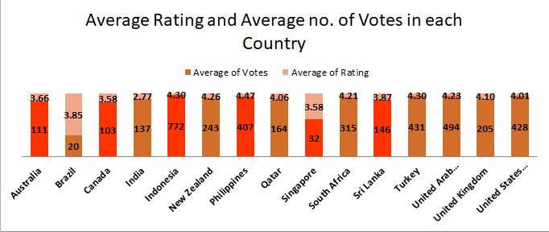
Suggested Countries Having High Market Potential
To identify ideal countries for expansion, I focused on regions with a low number of restaurants but strong customer engagement and satisfaction. The aim was to find high-appeal markets that are not yet saturated but show clear potential.
Indonesia:
•Indonesia shows strong interest, with a 4.3 rating from 772 votes.
•Only 22 restaurants in 4 cities point to low competition and limited reach.
•This makes Indonesia a strategic choice for early expansion, allowing us to meet existing demand and grow ahead of competitors.
Philippines:
•The country holds a solid 4.5 average rating, which clearly shows people enjoy what's being offered.
•But despite interest across 9 cities, there are only 22 restaurants, so the overall presence still feels minimal.
•This indicates a clear gap between demand and availability, making it the right time to deepen our footprint in existing cities and scale further.

Slide 16
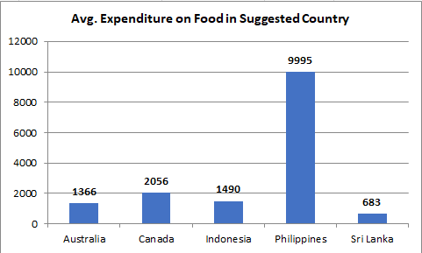
Food Expenditure Trends in The Suggested Countries
To understand how people spend on dining, I compared the average cost for two across all suggested countries. This gave a clear picture of affordability and spending behavior, key to shaping our pricing and setup.
•In Sri Lanka and Indonesia, food is affordable. We should consider simple, cost-effective restaurant models here, with value-driven pricing to attract a broader audience.
•In Australia and Canada, spending is moderate. With smart cost control and the right locations, we can position mid-range outlets that balance quality with profitability.
•In the Philippines, spending is significantly higher. This signals an opportunity for premium restaurants in urban hubs where customers are ready to pay more for a refined experience.

Slide 17
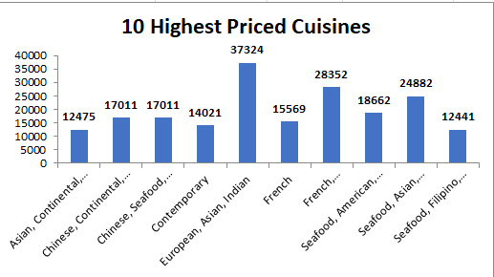
CUISINE PERFORMANCE
Fusion cuisines command premium pricing — combos like European, Asian, Indian reach up to ₹37,324.
Seafood boosts value — consistently appears in high-priced pairings across regions.
Global blends attract affluent diners — strategic combinations enhance exclusivity and market appeal.

Slide 18
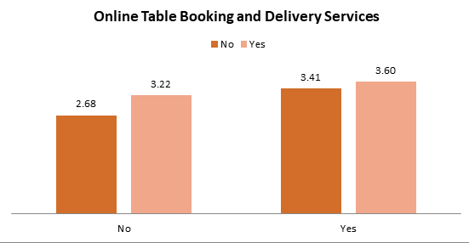
ONLINE DELIVERY AND TABLE BOOKING SERVICES
To understand the effect of online services on customer satisfaction, I compared ratings and vote counts between restaurants that offer delivery or table booking and those that don't. The idea was to understand if there is a pattern in customer ratings and engagement based on service availability. This helped determine whether offering these features in suggested expansion countries—where they’re currently missing—could lead to better ratings and higher engagement.
Insights
•In regions where these services are available, restaurants show consistently higher ratings and vote counts.
•For example, in India, restaurants with online services have an average rating of 3.6, while those without average only 2.5.
•The clear difference in ratings (3.6 vs. 2.5) strongly supports the positive impact of these services on customer satisfaction.

Slide 19
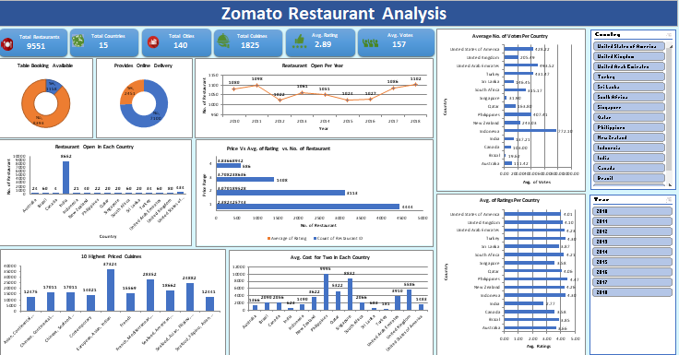
DASHBOARD

Slide 20
CONCLUSION
•This analysis offers strategic insights by studying key aspects such as price range, customer ratings, average cost for two, and the number of votes. These factors help understand market potential and customer behavior across countries.
•Important business questions have been addressed through a clear and interactive dashboard that uses visuals like line charts, column charts, pie charts, and slicers for better understanding.
•The use of country and year slicers allows users to easily filter and explore the data specific to different regions and timeframes.
•Additional findings, such as top cuisines among all countries, based on ratings, names of States and cities in the suggested countries, the current quality regarding ratings, are also included in the attached spreadsheet for clarity and planning.

Slide 21
STRATEGIC RECOMMENDATION
•Target high-potential countries like Sri Lanka, Indonesia, and the Philippines where restaurant presence is still low but customer interest is strong.
•Start in less crowded cities within these countries to avoid heavy competition and build a loyal customer base early.
•Learn from top competitors to offer something better—whether it’s unique food, faster service, or a more inviting dining experience.
•Add online delivery and table booking from the start—data shows it improves both customer experience and restaurant ratings.
•Serve popular cuisines that customers already love in each country to increase satisfaction and footfall.
•Keep pricing smart and local-friendly by matching it with how much people usually spend in each region.

Slide 22

THANK YOU

